Slide 1


Operating Systems
Unit- V : MEMORY MANAGEMENT
5.5 Paging (Part-2)
Dr. K. Ramachandra Rao
Assoc. Prof., Dept. of C.S.E.
Shri Vishnu Engineering College for Women (A), Bhimavaram

Slide 2
Shared Pages
Shared code
One copy of read-only (reentrant) code shared among processes (i.e., text editors, compilers, window systems)
Similar to multiple threads sharing the same process space
Also useful for interprocess communication if sharing of read-write pages is allowed
Private code and data
Each process keeps a separate copy of the code and data
The pages for the private code and data can appear anywhere in the logical address space

Slide 3
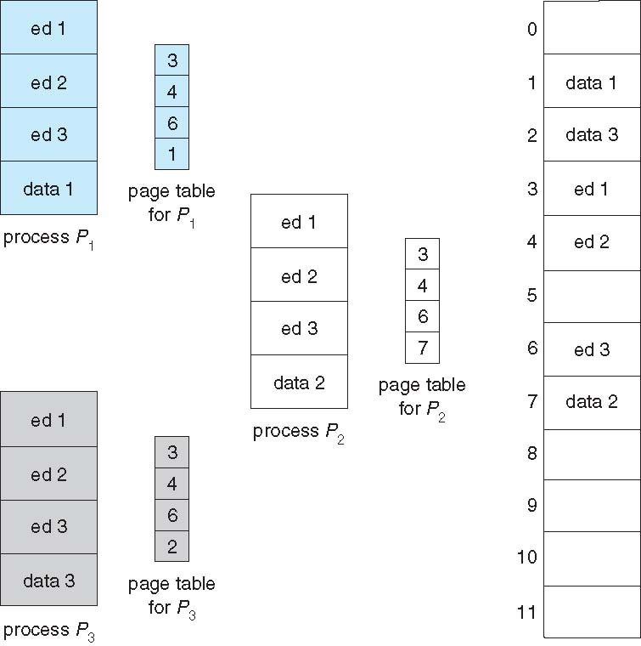
Shared Pages Example

Slide 4
Structure of the Page Table
Memory structures for paging can get huge using straight-forward methods
Consider a 32-bit logical address space as on modern computers
Page size of 4 KB (2¹²)
Page table would have 1 million entries (2³² / 2¹²)
If each entry is 4 bytes -> 4 MB of physical address space / memory for page table alone
That amount of memory used to cost a lot
Don’t want to allocate that contiguously in main memory
Hierarchical Paging
Hashed Page Tables
Inverted Page Tables

Slide 5
Hierarchical Page Tables
Break up the logical address space into multiple page tables
A simple technique is a two-level page table
We then page the page table

Slide 6
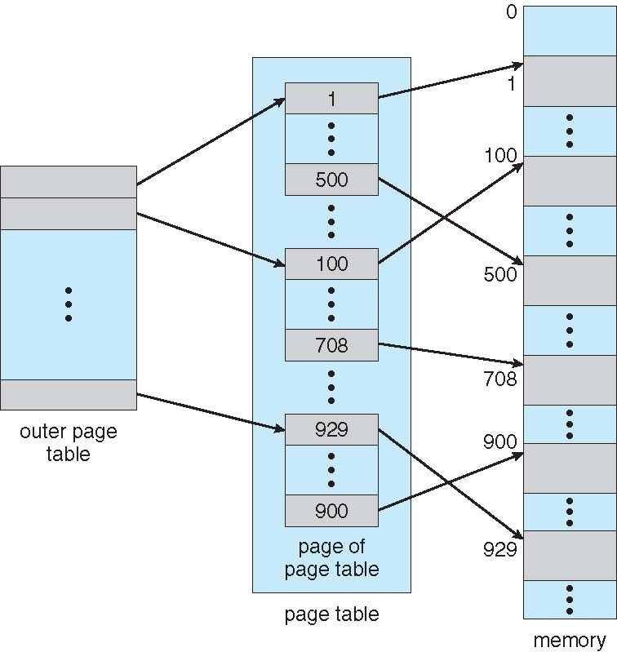
Two-Level Page-Table Scheme

Slide 7
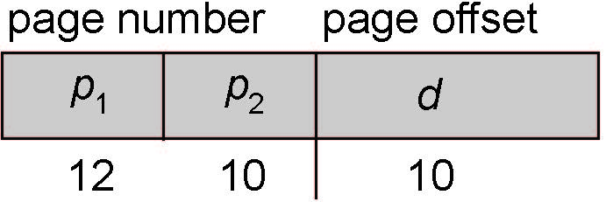
Two-Level Paging Example
A logical address (on 32-bit machine with 1K page size) is divided into:
a page number consisting of 22 bits
a page offset consisting of 10 bits
Since the page table is paged, the page number is further divided into:
a 12-bit page number
a 10-bit page offset
Thus, a logical address is as follows: where p₁ is an index into the outer page table, and p₂ is the displacement within the page of the inner page table
Known as forward-mapped page table

Slide 8
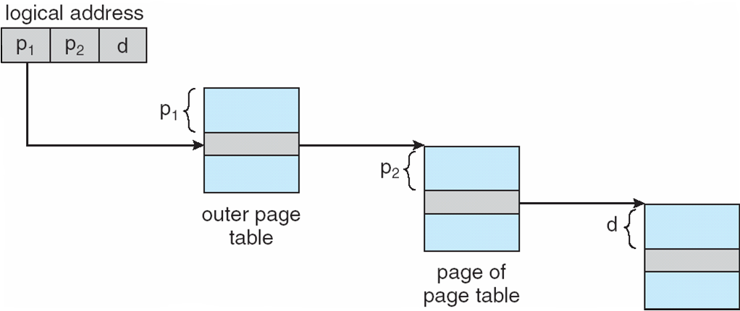
Address-Translation Scheme

Slide 9
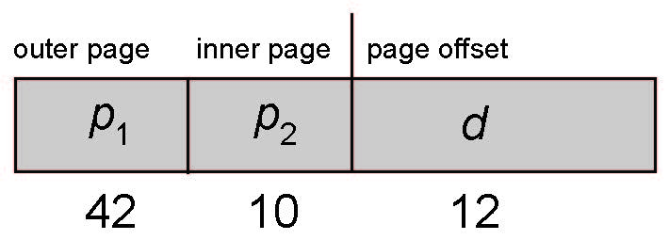
64-bit Logical Address Space
Even two-level paging scheme not sufficient
If page size is 4 KB (2¹²)
Then page table has 2⁵² entries
If two level scheme, inner page tables could be 2¹⁰ 4-byte entries
Address would look like
Outer page table has 2⁴² entries or 2⁴⁴ bytes
One solution is to add a 2nd outer page table
But in the following example the 2nd outer page table is still 2³⁴ bytes in size
And possibly 4 memory access to get to one physical memory location

Slide 10
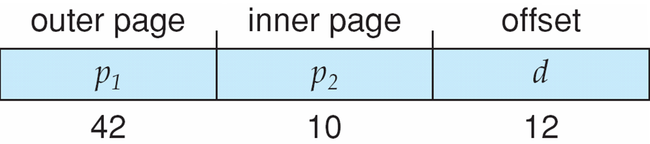
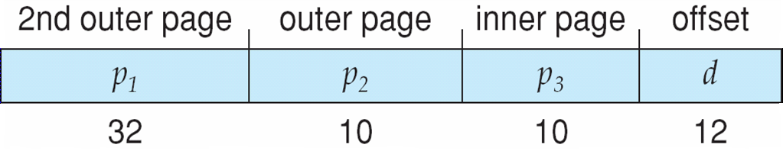
Three-level Paging Scheme

Slide 11
Hashed Page Tables
Common in address spaces > 32 bits
The virtual page number is hashed into a page table
This page table contains a chain of elements hashing to the same location
Each element contains (1) the virtual page number (2) the value of the mapped page frame (3) a pointer to the next element
Virtual page numbers are compared in this chain searching for a match
If a match is found, the corresponding physical frame is extracted
Variation for 64-bit addresses is clustered page tables
Similar to hashed but each entry refers to several pages (such as 16) rather than 1
Especially useful for sparse address spaces (where memory references are non-contiguous and scattered)

Slide 12
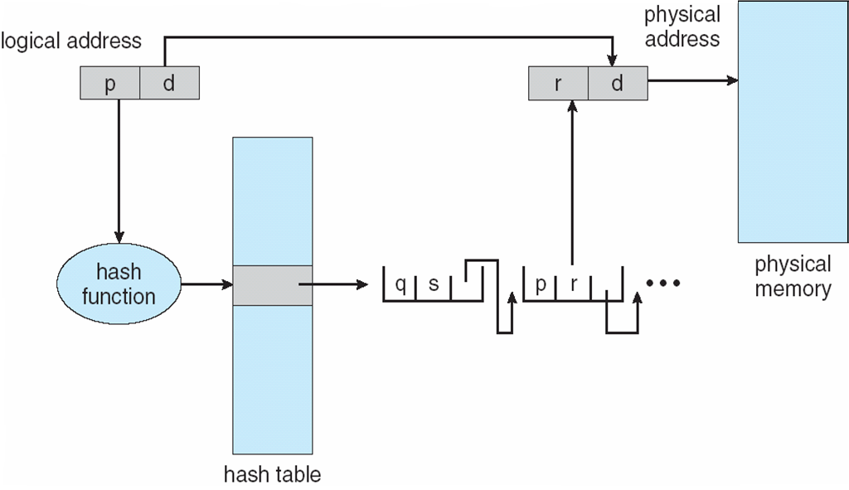
Hashed Page Table

Slide 13
Inverted Page Table
Rather than each process having a page table and keeping track of all possible logical pages, track all physical pages
One entry for each real page of memory
Entry consists of the virtual address of the page stored in that real memory location, with information about the process that owns that page
Decreases memory needed to store each page table, but increases time needed to search the table when a page reference occurs
Use hash table to limit the search to one — or at most a few — page-table entries
TLB can accelerate access
But how to implement shared memory?
One mapping of a virtual address to the shared physical address

Slide 14
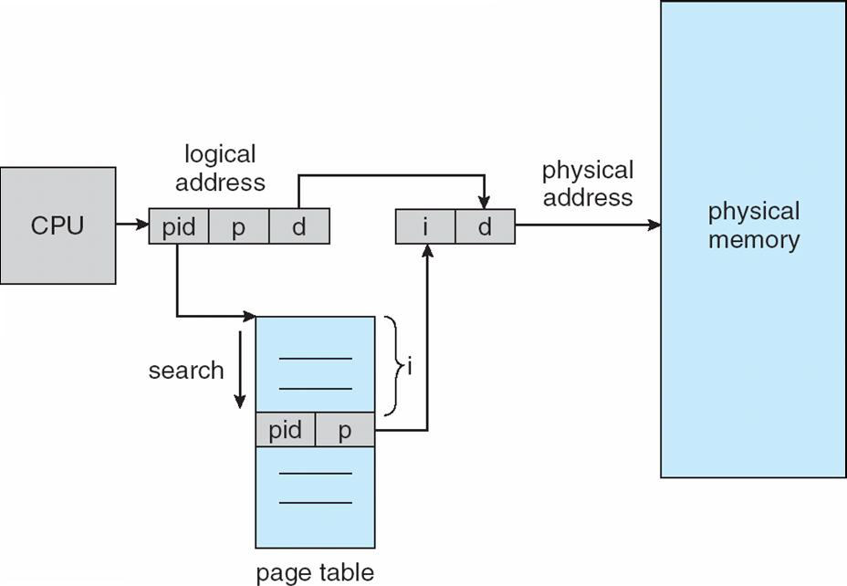
Inverted Page Table Architecture

Slide 15
THANK YOU
Dr. K. Ramachandra Rao
Assoc. Prof., Dept. of C.S.E.
Shri Vishnu Engineering College for Women (A), Bhimavaram

